Slide 1


Refresher on Mutual Fund Exemptions
Jack MacDonald
Notes:
Good afternoon. My name is Jack MacDonald. I work for the Office of Government Ethics in the Presidential Nominations Branch.
Welcome to a Refresher on Mutual Fund Exemptions.

Slide 2
18 U.S.C. § 208
Government employees are prohibited from participating personally and substantially in a particular government matter that will have a direct and predictable effect on their financial interests, including the financial interests of others, which are attributed to the federal employee.
Purpose: To prevent an employee’s personal interests from influencing Government decisions
Notes:
As you know, we have a criminal conflict of interest statute, 18 USC 208, that prohibits Government employees from participating personally and substantially in particular matters that will have a direct and predictable effect on their financial interests.
While we have several options available to remedy a conflict: Recusal, divestiture, and in certain situations, a 208 waiver --
There may also be an exemption to the statute that would apply that would allow the Government employee to participate in the matter.
This afternoon we are going to take a closer look at two these exemptions, the exemptions for diversified and sector mutual funds.

Slide 3
A few words about exemptions
Only OGE is authorized to issue
They are housed in 5 CFR 2640
They apply automatically (unless you have a statute or regulation that trumps them)
They mitigate both the conflict AND any appearance concerns
Notes:
Now…just a few reminders about exemptions….
Bullet 3: example is a type of prohibited holding

Slide 4
Analysis Process
1. Will the outcome of the Government matter have an effect upon the identified interest?
2. Can you identify a potential exemption?
3. Does the exemption cover this type of financial interest?
4. Does the exemption cover this type of particular matter?
5. Where applicable, does the $ value of the interest meet the de minimis thresholds of the exemption?
Notes:
As we prepare to run through an exercise I’ve prepared, let’s review the analysis process for using an exemption.
We have to answer these questions to figure out if we can use an exemption.

Slide 5
Applying the Exemptions Exercise
An employee of the FDA will be working on reviewing and approving requests by drug companies for new medicines. The employee’s investment portfolio consists of:
  $100,000 invested in the Janus Emerging Markets Fund
  $55,000 invested in the T. Rowe Price Health Sciences Fund
  $20,000 invested in the Vanguard Health Care Fund
  $75,000 invested in the iShares DJ U.S. Consumer Goods Fund
Notes:
For today’s session, I’ve selected an employee of the Food and Drug Administration who will be working on…
Among the assets in the employee’s investment portfolio are the following funds with these values.

Slide 6
1. Will the outcome of the matter affect the holding?
Matters:
Drug approvals
Interests:
Pooled investment vehicles
Notes:
Okay…to complete our analysis of these funds, we are going to have to answer a few questions.
To answer our first question, we have to look at the type of matter and the financial interests.
Will drug approvals affect the holdings of these pooled investment vehicles? Answer: Yes.
So we need to go to the next step in our analysis process because if we don’t we are going to have to consider all of the underlying assets of each investment.

Slide 7
2. Which exemption might apply?
5 CFR 2640.201
Exemptions for interests in mutual funds, unit investment trusts, and employee benefit plans.
Notes:
Next…can we identify a potential exemption?
Given that we are looking at pooled investment vehicles, we think to look at the exemptions for mutual funds, which are among the exemptions found in 5 CFR 2640.201.

Slide 8
3. Is it a mutual fund?
Mutual fund means an entity which is registered as a management company under the Investment Company Act of 1940, as amended (15 U.S.C. 80a–1 et seq.). For purposes of this part, the term mutual fund includes open-end and closed-end mutual funds and registered money market funds.
  5 CFR § 2640.102(k)
Notes:
If we want to use the exemption for mutual funds, we need to verify that we are looking at a mutual fund.
Most of our verification of a mutual fund’s name can be completed by looking up the name of the fund on a financial website like Google Finance, Yahoo Finance, etc. If you can see that the fund is publicly traded (i.e., has a ticker symbol THAT ENDS WITH AN ‘X’), you will know that it is registered under the 1940 Act. In cases where you can’t find the fund on a website such as Google Finance or Yahoo Finance, you should go to the SEC’s EDGAR website to complete a search.

Slide 9
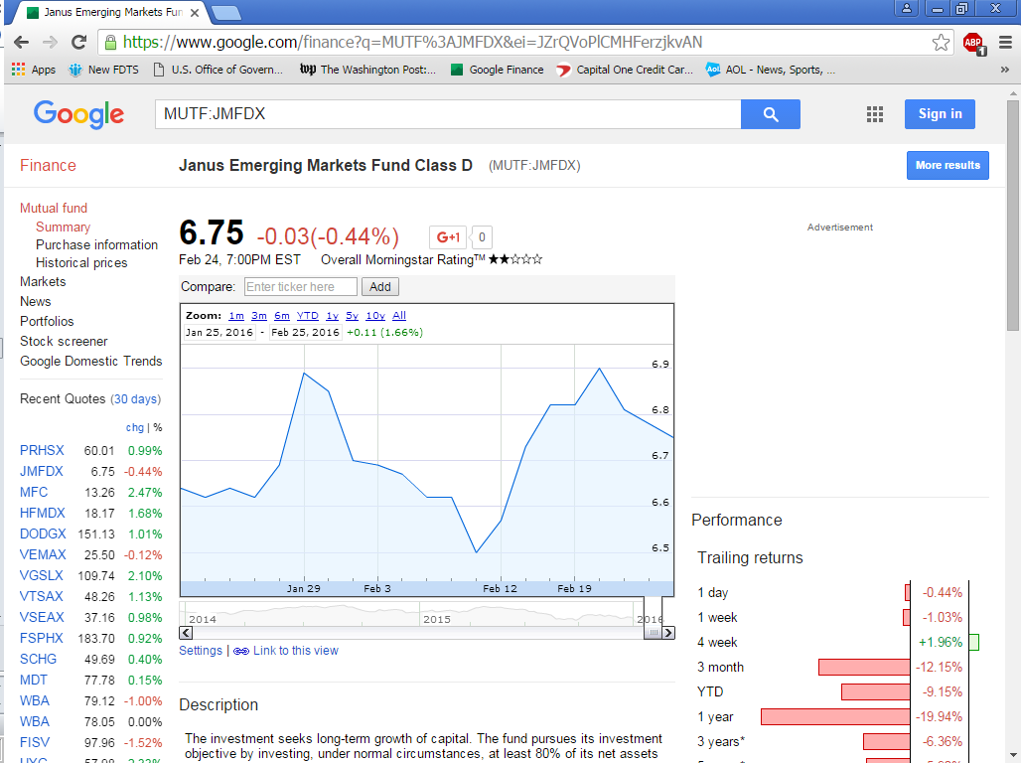
Notes:
Now, I’ve gone ahead and looked each of these funds up for us to verify the names that our FDA employee disclosed on his financial disclosure report.
As you gain more experience with financial disclosure and these funds become more familiar to you, you won’t always have to look them up.
Here we see a ticker symbol circled at the top, so we are okay.

Slide 10
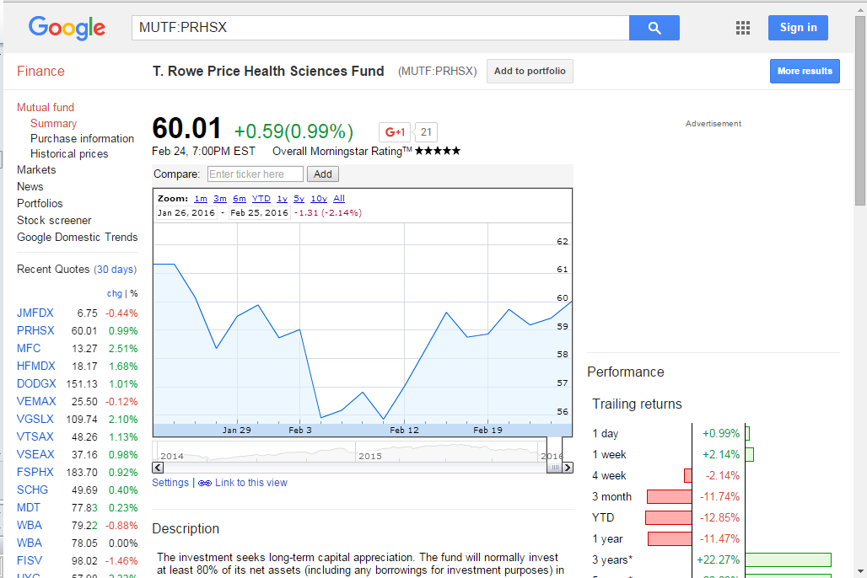
Notes:
Same for our second fund.

Slide 11
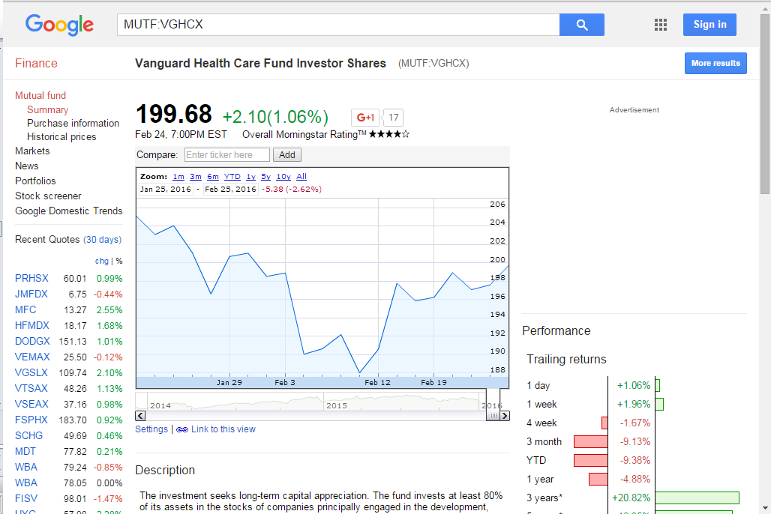
Notes:
And for our third fund.

Slide 12
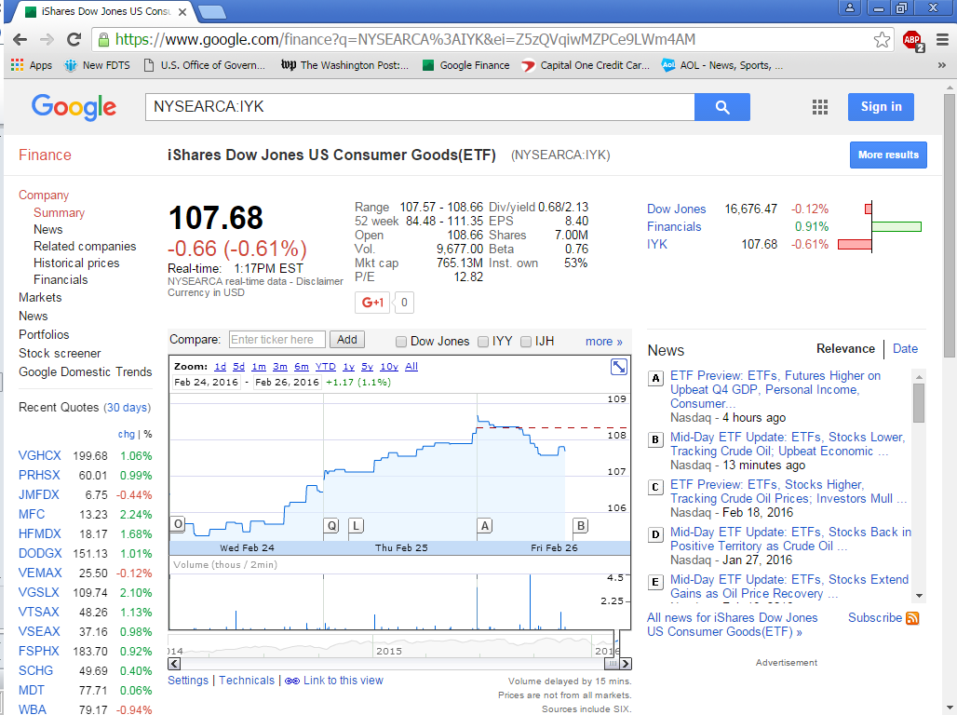
Notes:
What about here? Here we have an Exchange Traded Fund or “ETF.” You’ll notice that the ticker symbol is different. Three letters instead of the five we see for a mutual fund.
Go to NEXT SLIDE to discuss ETFs.

Slide 13
Exchange Traded Funds (ETFs)
Most exchange-traded funds are:
    organized either as open-end investment management companies or as unit investment trusts
    registered with the Securities and Exchange Commission (SEC) under the same statutory authorities as traditional mutual funds
    qualify for the exemptions in 5 C.F.R. Part 2640 for mutual funds and unit investment trusts
Notes:
Okay, a few words about Exchange Traded Funds…
ONLY IF ASKED: A unit investment trust (UIT) is a type of investment company regulated under the Investment Company Act of 1940. A UIT buys a relatively fixed portfolio of securities and holds them with little or no change until the UIT’s termination date.

Slide 14
Caution:
ETFs invested in commodities and commodity futures usually do not meet the definitions for mutual fund or unit investment trust.
Example: iShares Gold Trust
Notes:
One thing to be careful about with ETFs invested in commodities and commodity futures…they won’t be registered with the SEC, they will be registered with the CFTC. So they won’t be registered under the Investment Company Act of 1940.

Slide 15


Is it a mutual fund?
Janus Emerging Markets Fund
T. Rowe Price Health Sciences Fund
Vanguard Health Care Fund
iShares DJ U.S. Consumer Goods Fund
status check
Notes:
Okay, we just took a look at our funds and found that each of them qualifies as a mutual fund.

Slide 16
4. Is it diversified or sector?
Does the mutual fund have a stated policy of concentrating its investments in an industry, business, single country other than the United States, or bonds of a single State within the United States?
  5 CFR § 2640.102(a)
Notes:
So our next question is…
If the fund does not have this policy, then it is a diversified fund.
If the fund does have this policy, then it is a sector fund.

Slide 17
REMEMBER
Excepted Investment Funds
  EIF = Reporting
  EIF ≠ Conflicts
Notes:
Now, an important reminder along the way about Excepted Investment Funds. The Excepted Investment Fund or “EIF” is a reporting concept only.
It has nothing to do with conflicts! So when you are trying to determine whether a fund is diversified or sector, you are not looking at whether it is an EIF, you are looking at whether it has a stated policy of concentrating its investments.

Slide 18
RESOURCES
OGE Guidance on Diversified and Sector Mutual Funds:
DO-00-030
LA-15-09 (Real estate funds)
Notes:
Two great resources to be aware of:
DO-00-030: Great resource. 16 page advisory, but there are two pages with samples for each type of fund – I keep a copy of the two pages on my desk.
LA-15-09: A fresh look at real estate funds that explains why some of these funds can now be treated as “diversified” (i.e., general real estate investments vs. specific real estate investments – “Healthcare” or Hotels and Resorts)

Slide 19
Janus Emerging Markets Fund
The investment seeks long-term growth of capital. The fund pursues its investment objective by investing, under normal circumstances, at least 80% of its net assets in securities of issuers in emerging market countries. It normally invests in securities of issuers that (i) are primarily listed on the trading market of an emerging market country; (ii) are incorporated or have their principal business activities in an emerging market country; or (iii) derive 50% or more of their revenues from, or have 50% or more of their assets in, an emerging market country.
Notes:
I’ve also pulled the fund summary for us.

Slide 20
T. Rowe Price Health Sciences Fund
The investment seeks long-term capital appreciation. The fund will normally invest at least 80% of its net assets (including any borrowings for investment purposes) in the common stocks of companies engaged in the research, development, production, or distribution of products or services related to health care, medicine, or the life sciences (collectively termed "health sciences"). While the fund can invest in companies of any size, the majority of fund assets are expected to be invested in large- and mid-capitalization companies.

Slide 21
Vanguard Health Care Fund
The investment seeks long-term capital appreciation. The fund invests at least 80% of its assets in the stocks of companies principally engaged in the development, production, or distribution of products and services related to the health care industry. These companies include, among others, pharmaceutical firms, medical supply companies, and businesses that operate hospitals and other health care facilities. It may also consider companies engaged in medical, diagnostic, biochemical, and other research and development activities. The fund may invest up to 50% of its assets in foreign stocks.

Slide 22
iShares DJ U.S. Consumer Goods Fund
The investment seeks to track the investment results of an index composed of U.S. equities in the consumer goods sector. The fund generally invests at least 90% of its assets in securities of the underlying index and in depositary receipts representing securities of the underlying index. It seeks to track the investment results of the Dow Jones U.S. Consumer Goods Index), which measures the performance of the consumer goods sector of the U.S. equity market. The fund is non-diversified.

Slide 23
iShares DJ U.S. Consumer Goods Fund (continued)
The Fund seeks investment results that correspond generally to the price and yield performance, before fees and expenses, of United States consumer goods stocks, as represented by the Dow Jones United States Consumer Goods Index. The Underlying Index measures the performance of the consumer goods sector of the United States equity market. The Underlying Index includes companies in a range of industry groups, which include automobiles and parts, beverages, food producers, household goods, leisure goods, personal goods and tobacco.

Slide 24


Is the fund diversified?
Janus Emerging Markets Fund
T. Rowe Price Health Sciences Fund
Sector fund not eligible for diversified exemption
Vanguard Health Care Fund
Sector fund not eligible for diversified exemption
iShares DJ U.S. Consumer Goods Fund
X
status check

Slide 25
5. Does the value of the interest meet the de minimis?
Is the aggregate market value of the employee’s interests in all sector mutual funds that concentrate in the same sector and have one or more holdings that might be affected by the particular matter $50,000 or less?
  5 CFR § 2640.201(b)(2)

Slide 26
Exemptions for mutual funds
Janus Emerging Markets Fund
T. Rowe Price Health Sciences Fund
$55,000 is above the de minimis for sector funds
Vanguard Health Care Fund
$20,000 is below the de minimis for sector funds
iShares DJ U.S. Consumer Goods Fund
status check
Notes:
Our final status check…
What would you do about the sector fund that was above the $50,000 de minimis threshold? You could sell all of it, or sell it down enough so that when combined with the Vanguard fund they would still both aggregate to an amount safely below the threshold. If you did this you would need to agree NOT TO PURCHASE ANY MORE OF EITHER FUND.
Hopefully this has provided you with a nice refresher on the mutual fund exemptions and how to apply them to the scenarios you are likely to encounter during the upcoming transition.

Slide 27


